Slide 1
Sudoku Solver Using Backtracking
DATA STRUCTURE & ALGORITHMS
Azlaan Mehmood (4110)
Sameer Ahmed (4170)
Atiya Bibi (4625)

Slide 2
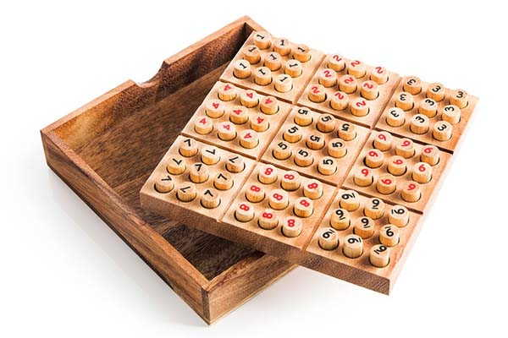
Sudoku is defined by Merriam-Webster as a 9-by-9 grid puzzle in which the grid is divided into 3-by-3 boxes. Every row, column and box must contain the numbers one through nine, no repeats.

Slide 3
Objectives :
The objective of this project is to implement a Sudoku Solver in C++ using the backtracking algorithm. Sudoku is a popular puzzle game that involves filling a 9x9 grid with digits from 1 to 9 while adhering to three basic rules:
Each row must contain the digits from 1 to 9 without repetition.
Each column must contain the digits from 1 to 9 without repetition.
Each 3x3 sub-grid must contain the digits from 1 to 9 without repetition.
The backtracking algorithm is used to solve this problem by trying different combinations for empty cells and backtracking whenever it hits an invalid configuration.

Slide 4
Project Description:
This project involves solving a Sudoku puzzle using C++. The program implements a solveSudoku function which attempts to solve the Sudoku puzzle using the backtracking technique. The backtracking technique systematically tries possible numbers for the empty cells in the grid and checks if the number can be placed validly according to Sudoku rules.

Slide 5
Key Functions:
printGrid(int grid[9][9]): This function prints the Sudoku grid in a readable format. It prints each row and separates the numbers with spaces for clarity.
isSafe(int grid[9][9], int row, int col, int num): This function checks if placing a number num at a given row and column is valid according to the rules of Sudoku:
It checks if the number already exists in the given row.
It checks if the number already exists in the given column.
It checks if the number already exists in the 3x3 sub-grid that contains the specified row and column.
solveSudoku(int grid[9][9]): This is the core function of the project. It applies backtracking to try and solve the Sudoku puzzle. It searches for an empty cell (represented by 0) and attempts to fill it with numbers from 1 to 9. If placing a number leads to a solution, it moves on to the next empty cell. If it reaches a point where no valid number can be placed, it backtracks by resetting the previous number and trying the next possibility.
main(): In the main function, a 9x9 Sudoku grid is defined. This grid is passed to the solveSudoku function. If the puzzle is solved, the solution is printed; otherwise, a message stating that no solution exists is displayed.

Slide 6
How the Code Works:
The grid is a 9x9 matrix, where 0 represents an empty cell. The program tries to solve this puzzle by placing numbers 1 to 9 in each empty cell and checking if the placement is valid using the isSafe function.
The solveSudoku function iterates over the grid to find an empty cell. It then tries numbers 1 to 9 in that cell and checks if each number is valid. If a number is valid, it is placed in the cell, and the function proceeds to solve the next empty cell recursively. If a conflict is encountered, the function backtracks by resetting the cell to 0 and trying the next number.
Once the puzzle is solved, the grid is printed in the main function. If no solution exists, a message is displayed.

Slide 7
Output Example:
For the given input grid, the program will output the solved Sudoku puzzle:
Solved Sudoku:
5 3 4 6 7 8 9 1 2
6 7 2 1 9 5 3 4 8
1 9 8 3 4 2 5 6 7
8 5 9 7 6 1 4 2 3
4 2 6 8 5 3 7 9 1
7 1 3 9 2 4 8 5 6
9 6 1 5 3 7 2 8 4
2 8 7 4 1 9 6 3 5
3 4 5 2 8 6 1 7 9

Slide 8
Conclusion:
This project demonstrates how to solve a Sudoku puzzle using backtracking, a classic algorithmic technique. The program takes an incomplete Sudoku puzzle as input and fills in the missing values while adhering to the rules of the game. This solution is efficient and works for all solvable Sudoku puzzles.

